Slide 1
What gives you the ring?
A basic analysis of NBA Champions’ stats from 2012-13 to 2023-24
A data analysis project by Christos Georgakakis
based on freely available data
uploaded by NocturneBear
on https://github.com/NocturneBear/NBA-Data-2010-2024
August, 2025

Slide 2
Key questions
What were the champions’ average stats in the playoffs from 2012-13 to 2023-24 ?
What were the champions’ ranks with respect to each stat type in the playoffs from 2012-13 to 2023-24?
How many times were champions ranked 1st or at least 2nd or at least 3rd, by stat type, in the playoffs from 2012-13 to 2023-24?
Were the champions’ offensive average stat ranks better than the defensive ones in the playoffs from 2012-13 to 2023-24?
What were the champions’ average stats in the regular season from 2012-13 to 2023-24 ?
What were the champions’ ranks with respect to each stat type in the regular season from 2012-13 to 2023-24?
How many times were champions ranked 1st or at least 2nd or at least 3rd, by stat type, in the regular season from 2012-13 to 2023-24?
Were the champions’ offensive average stat ranks better than the defensive ones in the regular season from 2012-13 to 2023-24?
How did the champions’ stats in the regular season differ from their playoffs stats from 2012-13 to 2023-24?
Are there any basic insights emerging from these questions ?

Slide 3
Method and tools used
Importing data to MySQL
SQL query based cleaning, processing and analysis
Exporting data to spreadsheets and reimporting them to MySQL or Google Sheets
Google Sheets cleaning, processing and visualizations
Tableu Public visualizations
Google Slides presentation

Slide 4
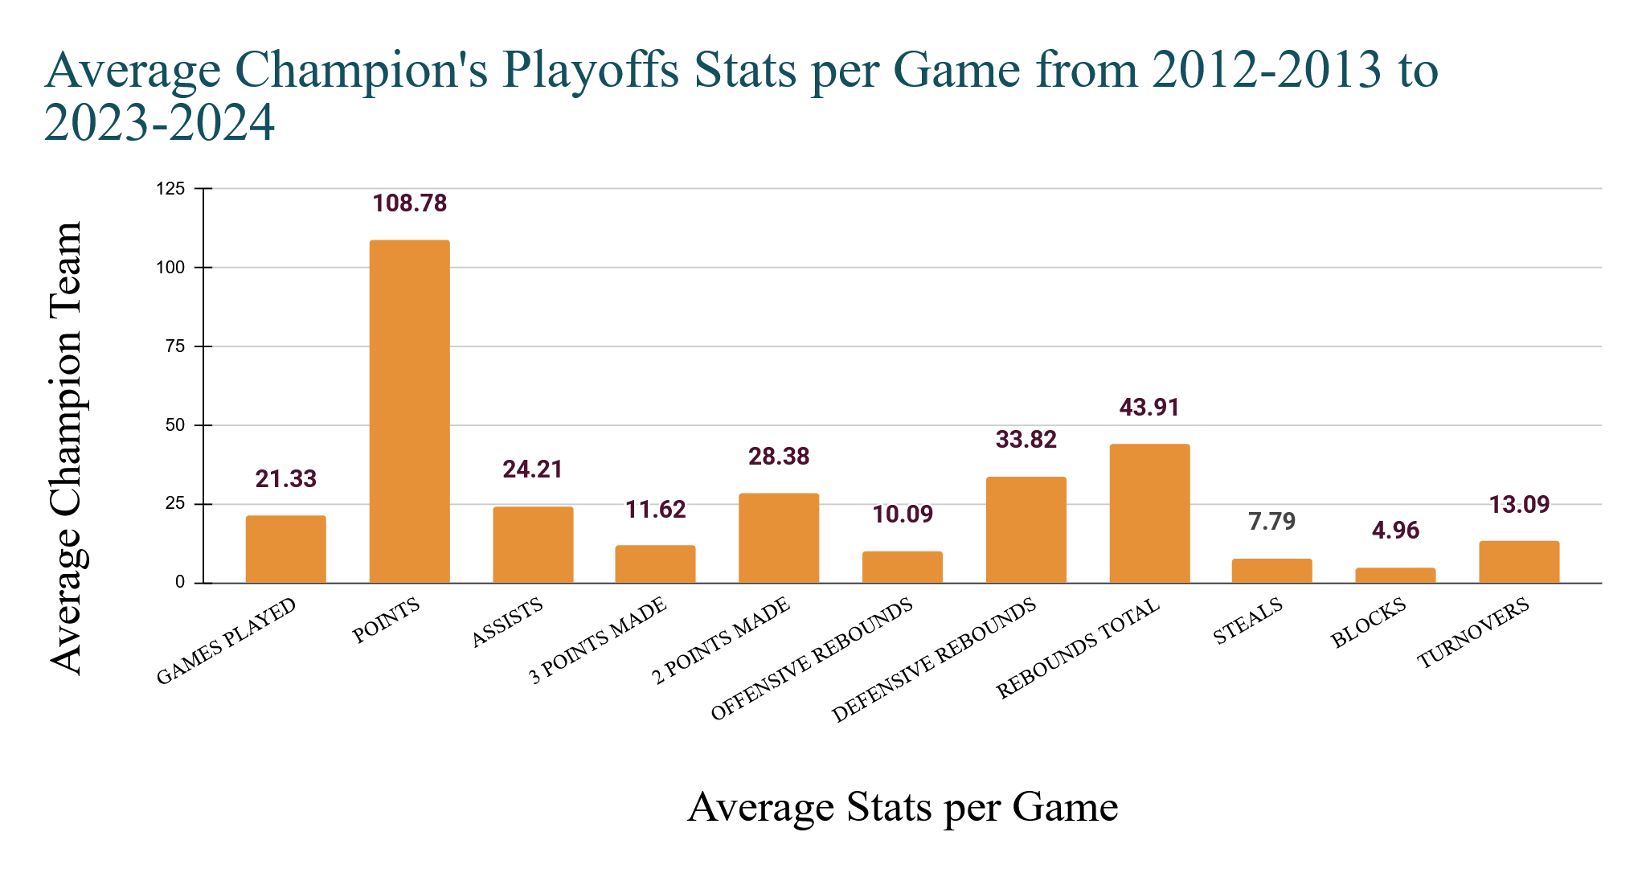

Slide 5
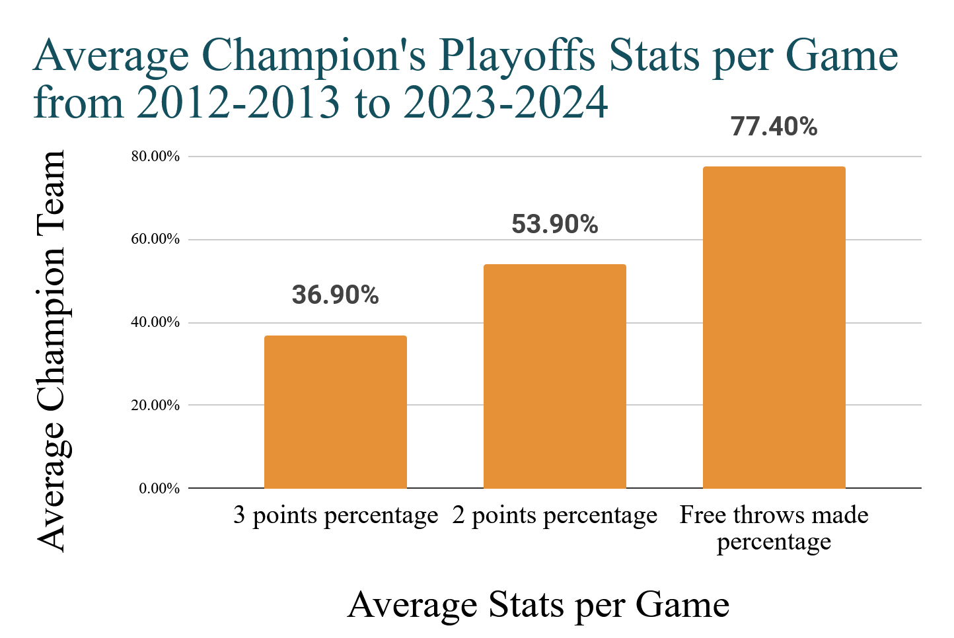

Slide 6
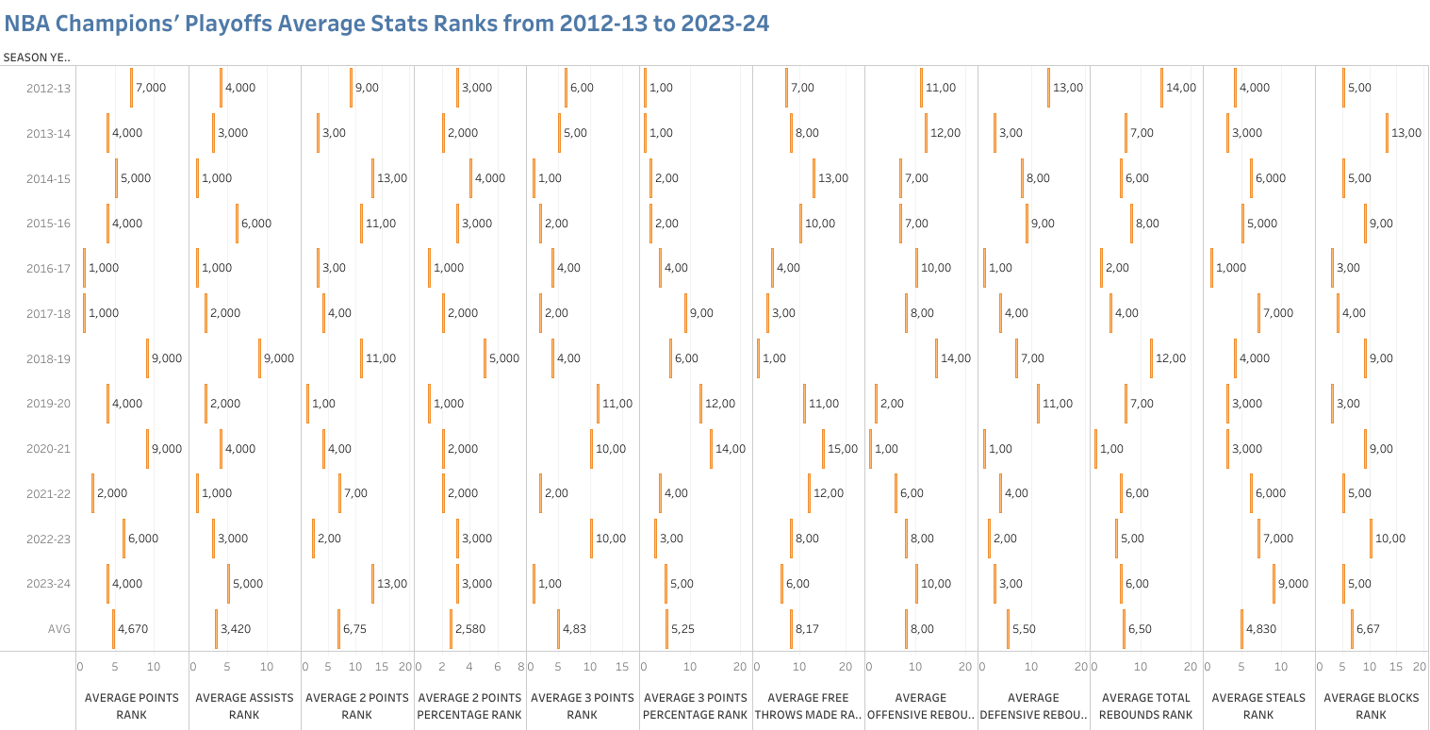

Slide 7
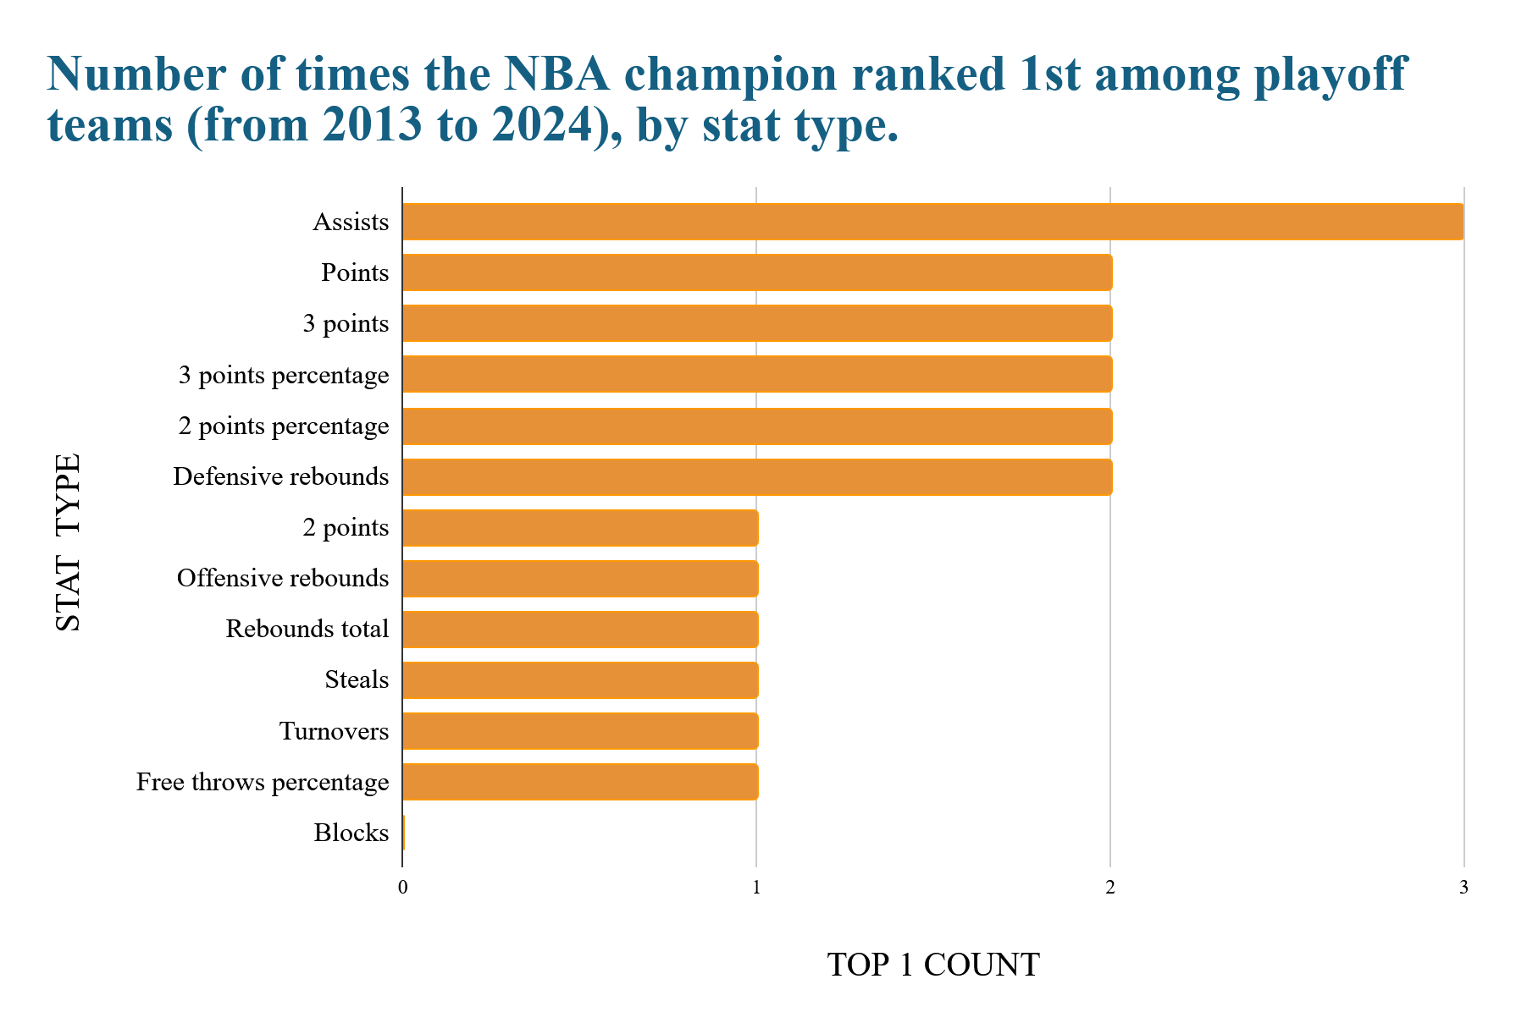

Slide 8
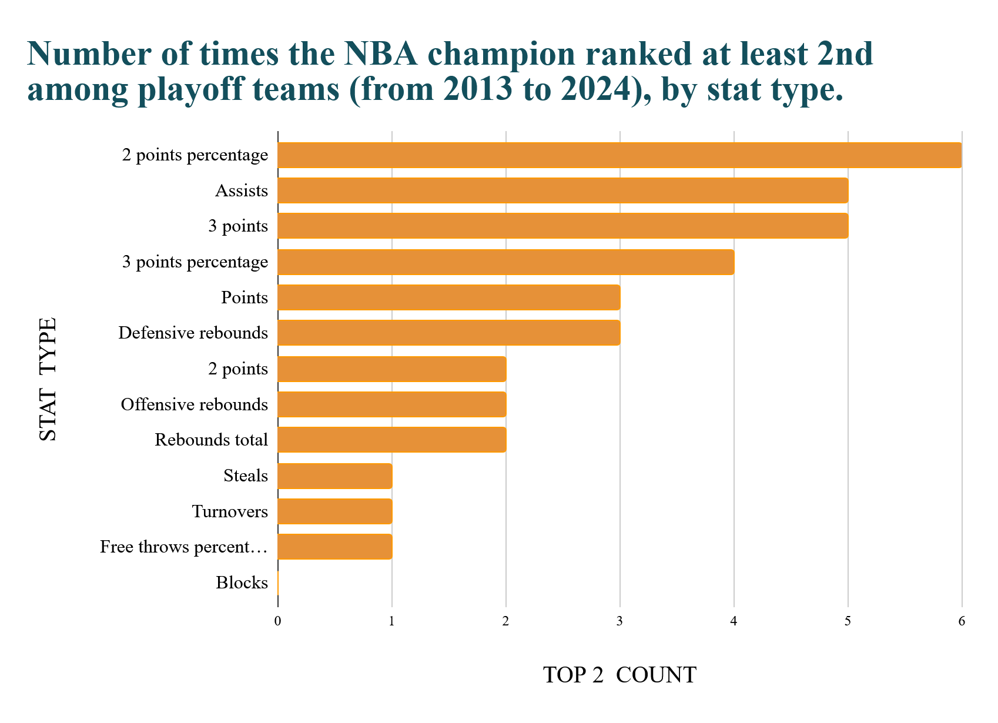

Slide 9
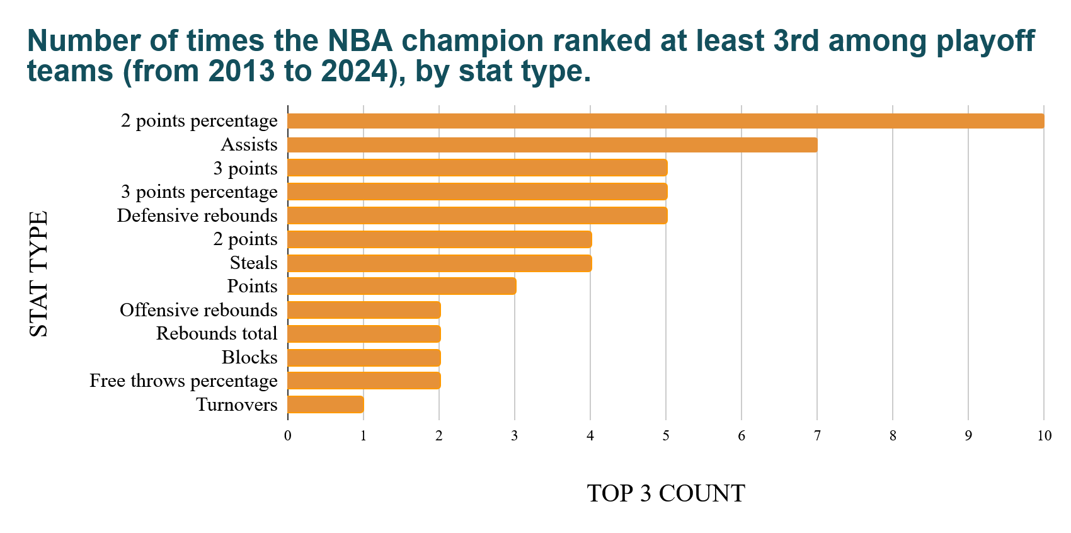

Slide 10
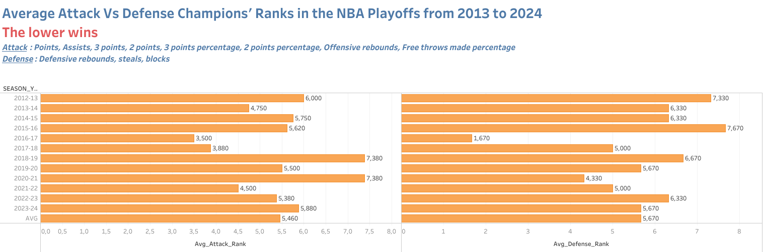

Slide 11
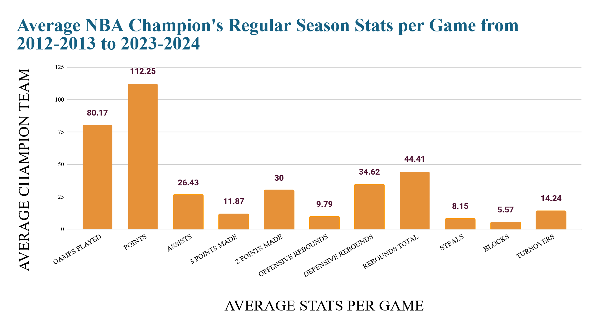

Slide 12
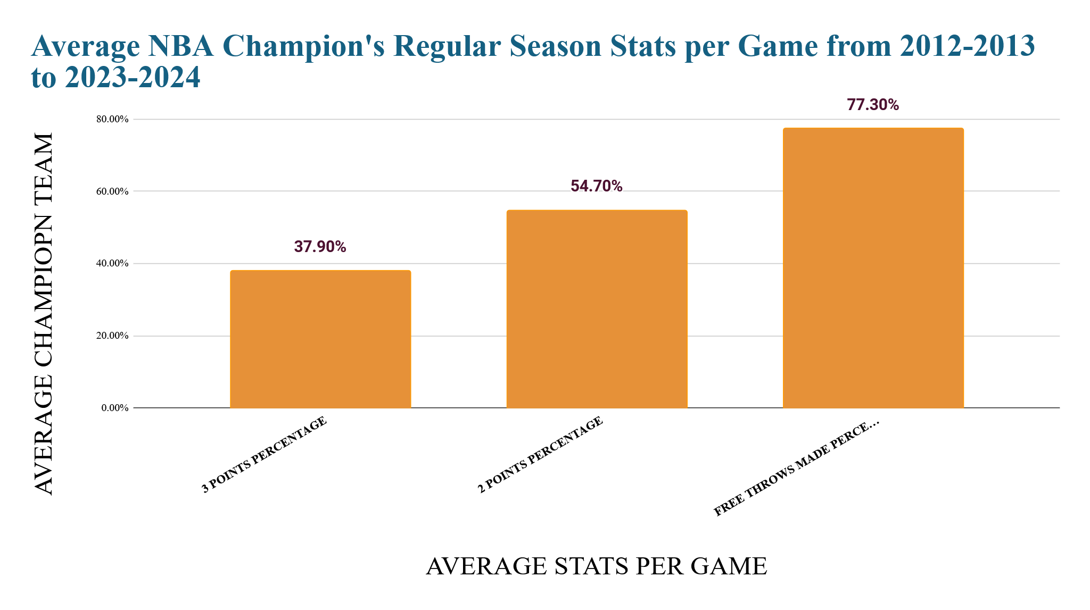

Slide 13
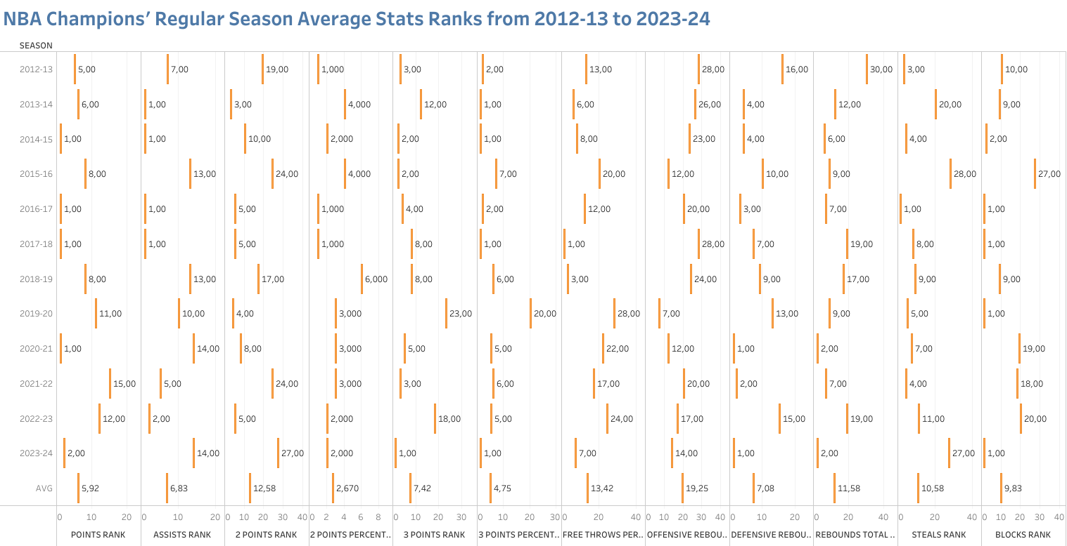

Slide 14
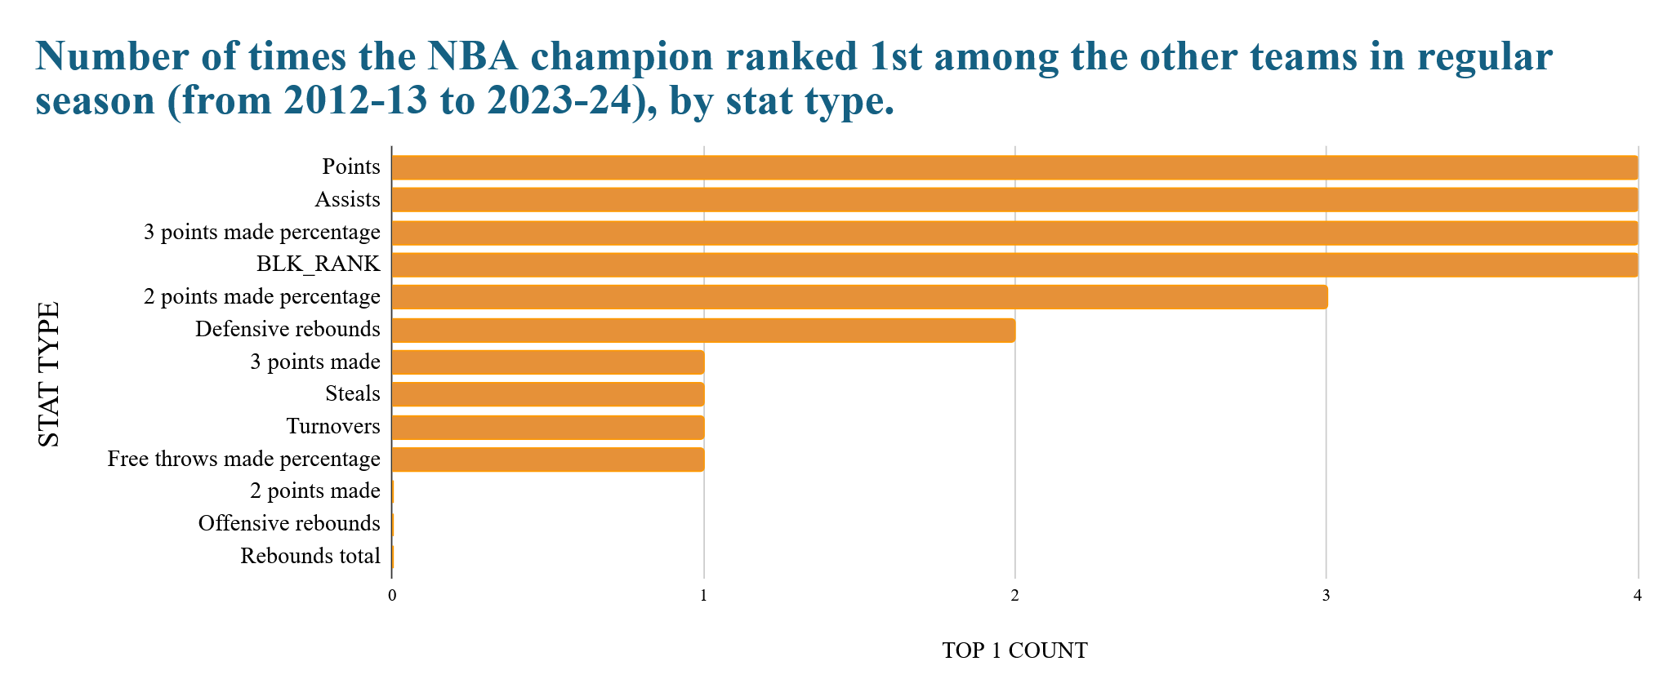

Slide 15
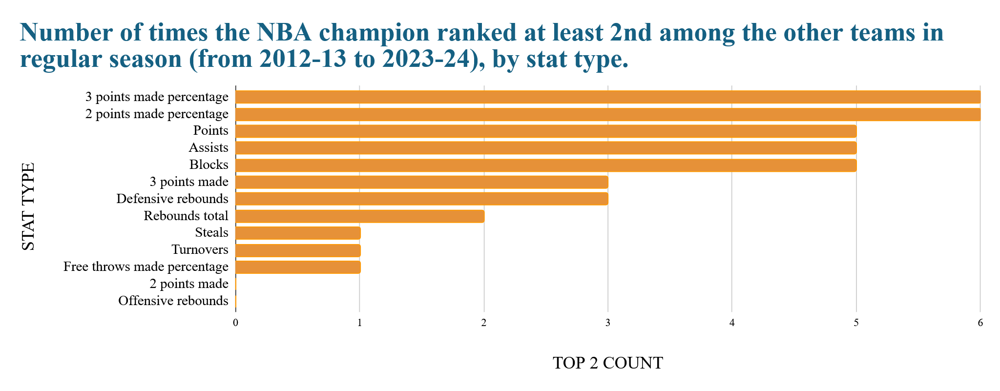

Slide 16
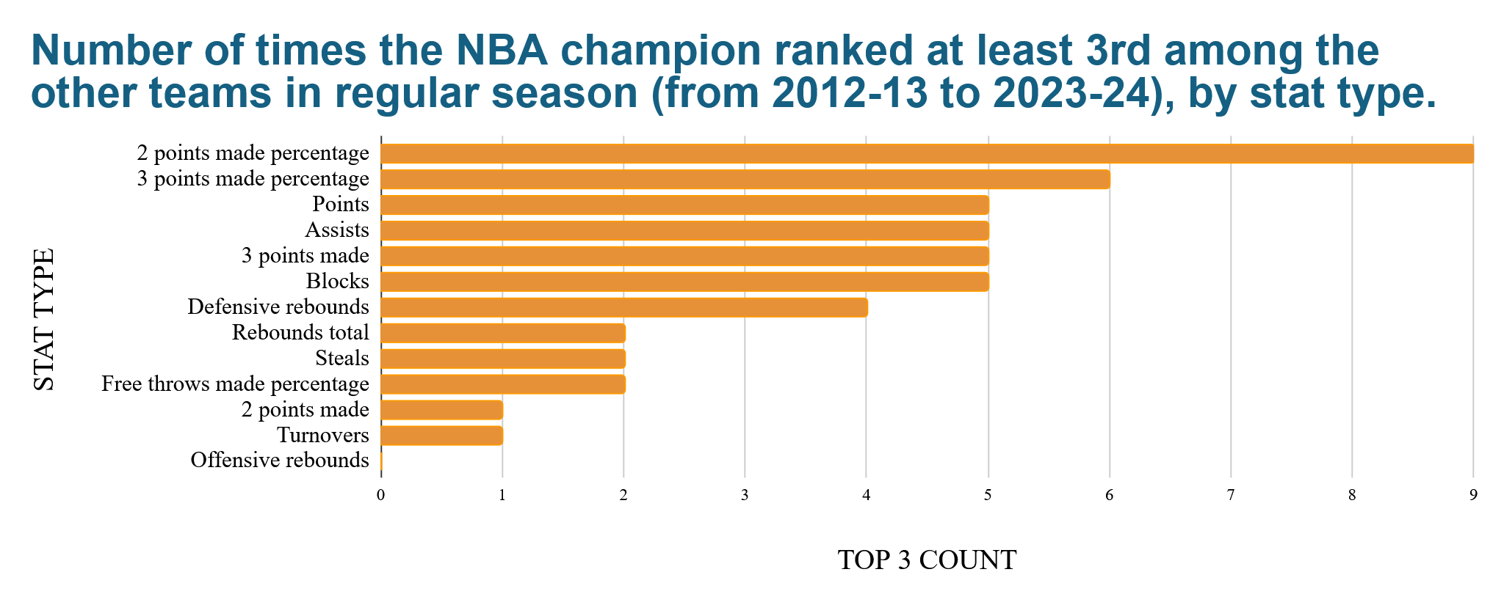

Slide 17
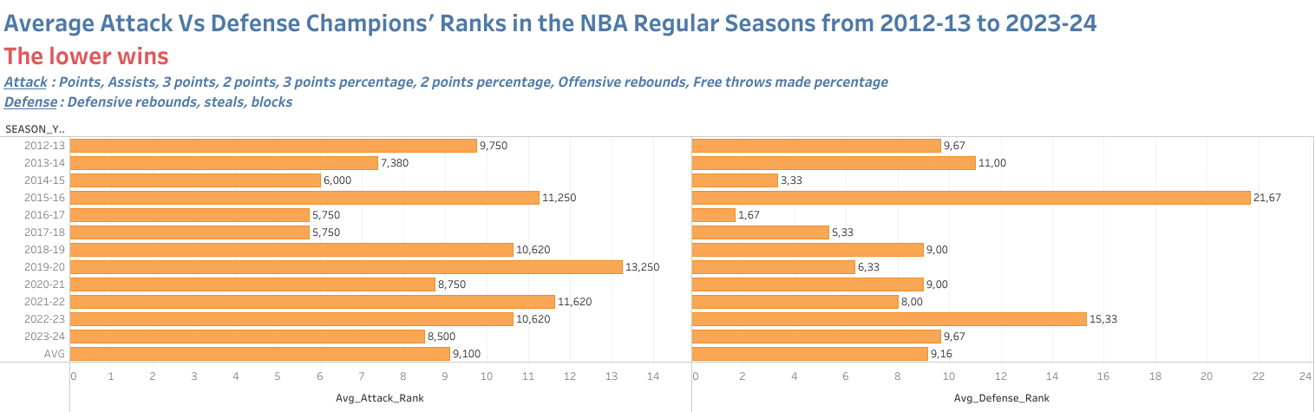

Slide 18
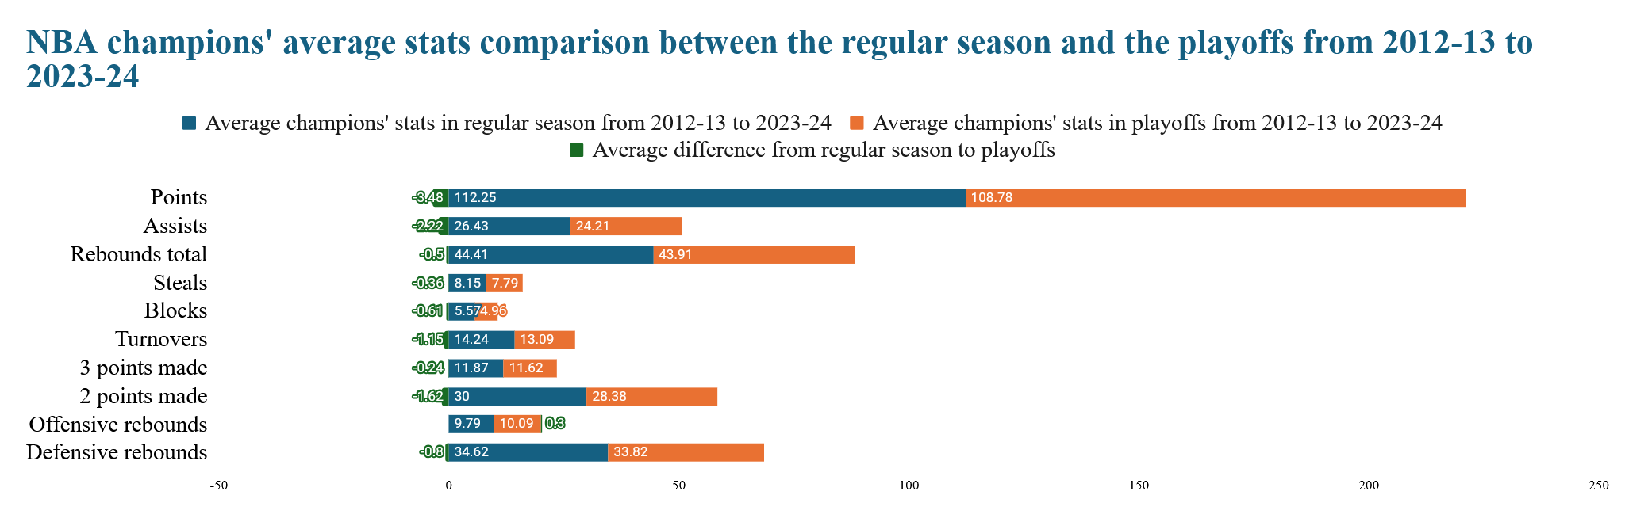
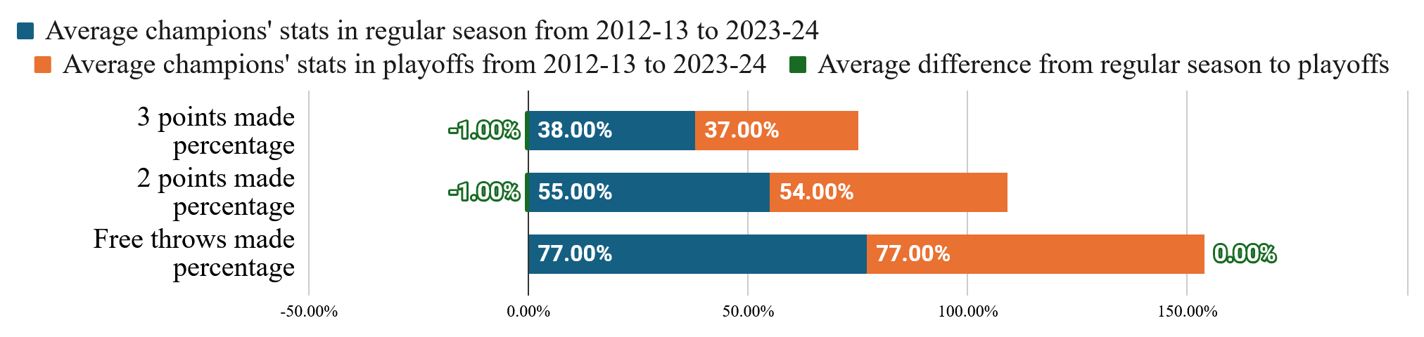

Slide 19
Key findings
From 2012–13 to 2023–24, the stat in which champions most often ranked at least 3rd among all playoff teams was 2-point field goal percentage (specifically 10 out of 12 seasons).
Champions were also ranked at least 3rd in assists in the playoffs 7 times (out of 12), at least 2nd 5 times, and 1st 3 times.
The stat in which champions were also most often ranked at least 3rd among all NBA teams in the regular season was again the 2-point field goal percentage (9 out of 12 times).
The champions’ average attack stats ranks were slightly but not significantly better than the average defense stats ranks both in the playoffs (5.46 vs 5.67) and in the regular season (9.10 vs 9.16)
There was minor difference between the champions’ average stats in the playoffs and the corresponding average stats in the regular seasons.

Slide 20
Key insights
NBA champions tend to shine in 2-points made percentage (54.7 % in the regular season and 53.9 % in the playoffs), very often being at least 3rd in this stat, both in the regular season (9 out of 12 seasons) and in the playoffs (10 out of 12 seasons). So, 2-points made percentage is highly associated with the ring pursuit.
Assists are also frequently associated with assisting the champions with approaching the ring (7 out of 12 times, the champions are ranked at least 3rd in assists)
Champions’ average attack stats ranks are only slightly better than their average defense stats ranks, in both the playoffs (where the champions are ranked in both attack and defense approximately 5th) and the regular season (where the champions are ranked approximately 9th). This means real champions do not normally prioritize attack over defense.
There is only a small difference of the champions’ average stats in the regular season from their stats in the playoffs, where they are slightly lower given the more intense competition at the final stage towards the title. This means that champions stay typically consistent from the regular season to the playoffs and that domination does not emerge as a firework only in the playoff stage, but it is rather built throughout the whole regular season.

Slide 21
Further research recommendations
Collect data from previous seasons and see whether the insights and findings about the last 12 seasons are confirmed or falsified by the expanded dataset.
Check whether there are any (groups of) playoffs stats that sufficiently together ensure getting the ring, and with respect to which champions outperform the other title contenders.
Experimenting with removing from the analysis seasons where the champions were ranked high with respect to many stat types, or seasons where the champions were not ranked high in many stat types.

Slide 22
Many thanks for your attention!

